Slide 1





DS Group
Project
Hospital Management
System

Slide 2
About Us
Shlok Prajapati
Enrollment No : 21002170110139
Roll No : 9
Raj Shah
Enrollment No : 21002170110148
Roll No : 26
Krishna Patel
Enrollment No : 21002170110108
Roll No : 40
Aaliya Rangoonwala
Enrollment No : 21002170110152
Roll No : 41
Diya Shah
Enrollment No : 21002170110171
Roll No : 43

Slide 3
Table of Contents
Introduction
Approach
Output
Advantages
Disadvantages

Slide 4
introduction
Hospital Management System is a system created using Linked List which enables hospitals to manage information and data related to all aspects of healthcare – processes, providers, patients, and more, which in turn ensures that processes are completed swiftly and effectively.

Slide 5
Approach
Input ~ User can add a new patient record using input function.
Details ~ User can view various patient records using details function.
Edit ~ User can edit existing patient records using edit function.
Bill ~ User can view final patient’s bill using bill function.
Delete ~ User can delete patient record using delete function.

Slide 6
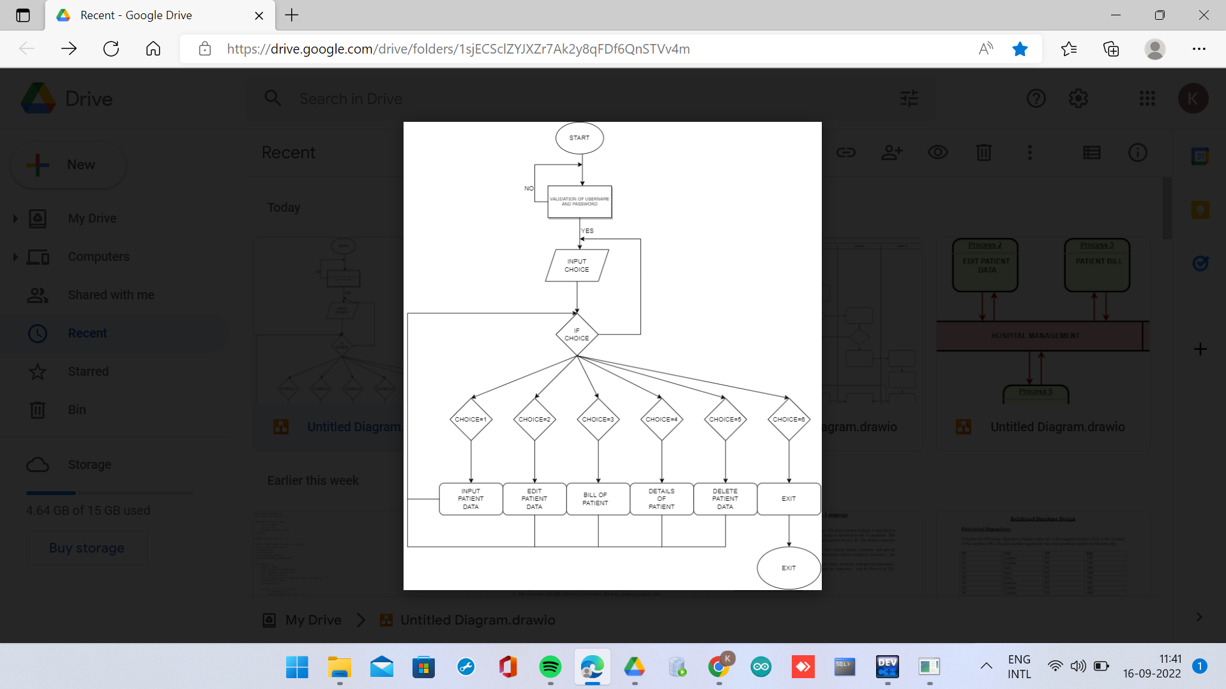
FLOWCHART

Slide 7
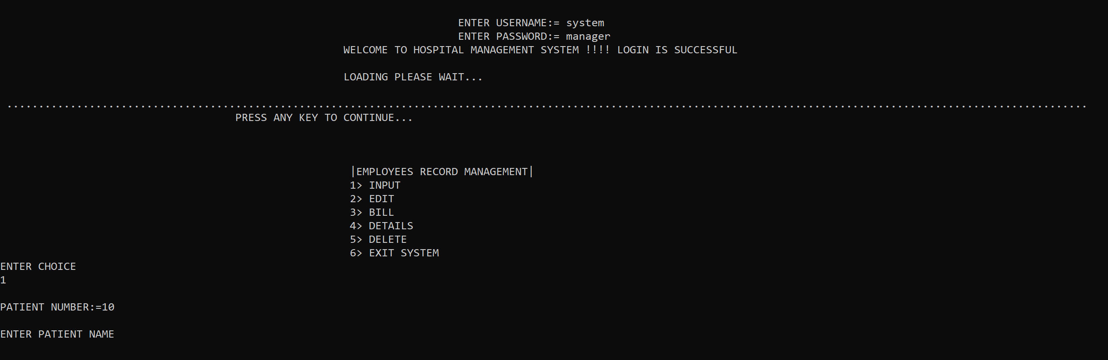
Output

Slide 8
advantages
Insertion and Deletion using linked lists are very efficient.
Linked List can also be expaned in Constant time.
Linked Lists are used for dynamic memory allocation which means effective memory utilization hence, there is no memory wastage.

Slide 9


Thank You

